Slide 1

forester: A Novel Approach to Accessible and Interpretable AutoML for Tree-Based Modeling
Anna Kozak , Hubert Ruczyński
Warsaw University of Technology
Notes:
Hello, I’m Anna Kozak, and together with Hubert Ruczyński, we want to present you a brief summary of the forester package.

Slide 2
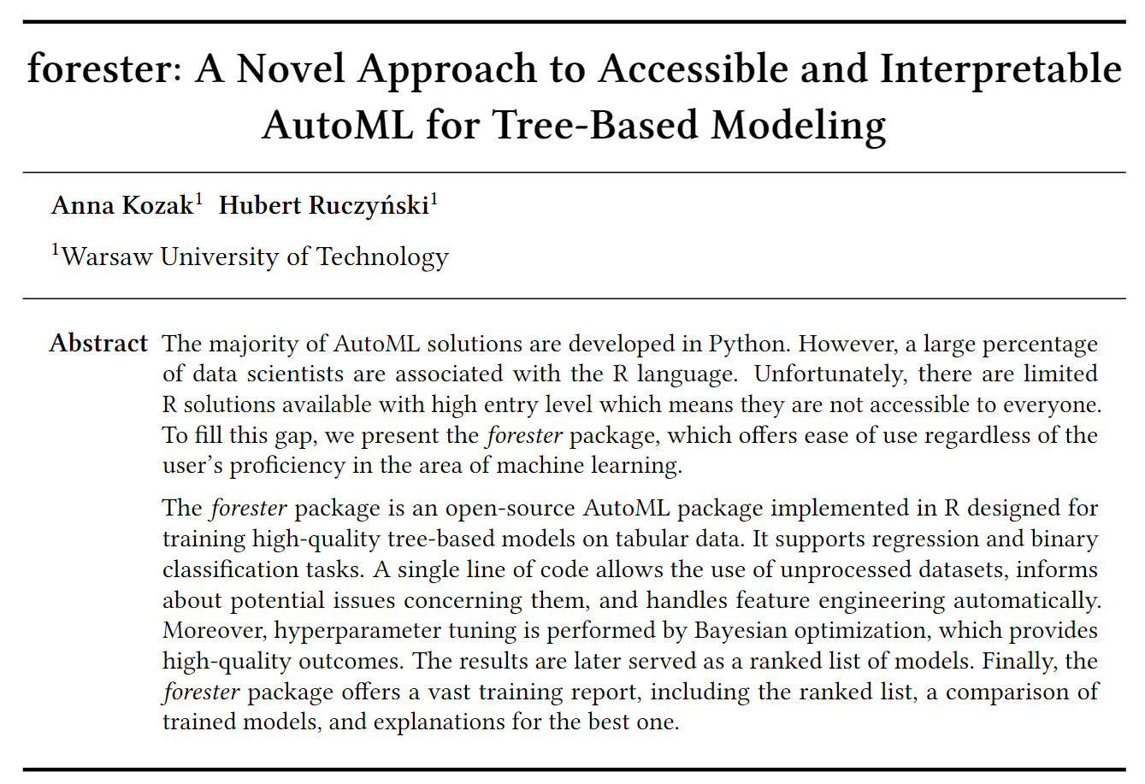
What is the forester?
Notes:
The forester is an AutoML tool in R for tabular data regression and binary classification tasks, that wraps up all machine learning processes into a single train() function, which includes:
1. rendering a brief data check report,
2. preprocessing the initial dataset enough for models to be trained,
3. training 5 tree-based models with default parameters, random search, and Bayesian optimization,
4. To finally evaluate them and provide a ranked list of results.

Slide 3
Why R?
Notes:
We’ve decided to implement our solution in R, as this language community covers lots of data scientists and statisticians, yet there are only a few AutoML solutions. Moreover, the frameworks like H2O AutoML or especially mlr3 require tons of domain knowledge which can be discouraging for new users, and they offer only a narrow spectrum of preprocessing options.

Slide 4
How to use it?
How to use it?
library(forester)
data(`lisbon`)
train_output <- train(lisbon,`Price`)
Notes:
The main strength of the forester is the simplicity of usage. With the traditional approach, the user has to install and use an abundance of packages, which results in a lengthy process of reading the documentation, implementing various approaches from scratch, and evaluating the outcomes. These steps result in lots of repetitive coding, and focusing on trivial tasks instead of proper and creative datascientists work. With our package, the user is able to do all of this with just a few lines of code!

Slide 5
forester pipeline
Notes:
The forester pipeline covers all major machine learning steps, starting from the data quality check, and data preparations, through the model training and tuning with various approaches to end with the model evaluation and comparison. Additionally we offer a wide range of extensive features, which lets us save the results, explain particular models, or even create a brief report on the training process.

Slide 6
Data preparation
The removal of static columns,
Binarization of target variable,
Removal of observations without a target,
Imputation of missing data with MICE,
Advanced method:
The removal of id-like columns,
The removal of highly correlated columns,
Feature selection with the BORUTA algorithm
Notes:
The most important part of the pipeline is the data preparation stage. This functionality makes the package easy to use for newcomers, as it lets them pass only the most basic information such as the dataset and target of the ML task, and the forester handles the rest itself. The basic preparation consists of the actions necessary for the package to work: removing static columns, binarization of the target variable, and imputing the missing data using the MICE algorithm.
We can also use the advanced method which additionally includes the removal of id-like columns, the removal of highly correlated columns, as well as feature selection with the BORUTA algorithm.
Additionally, every model in the forester package requires a different data format which is also prepared inside the main function.

Slide 7
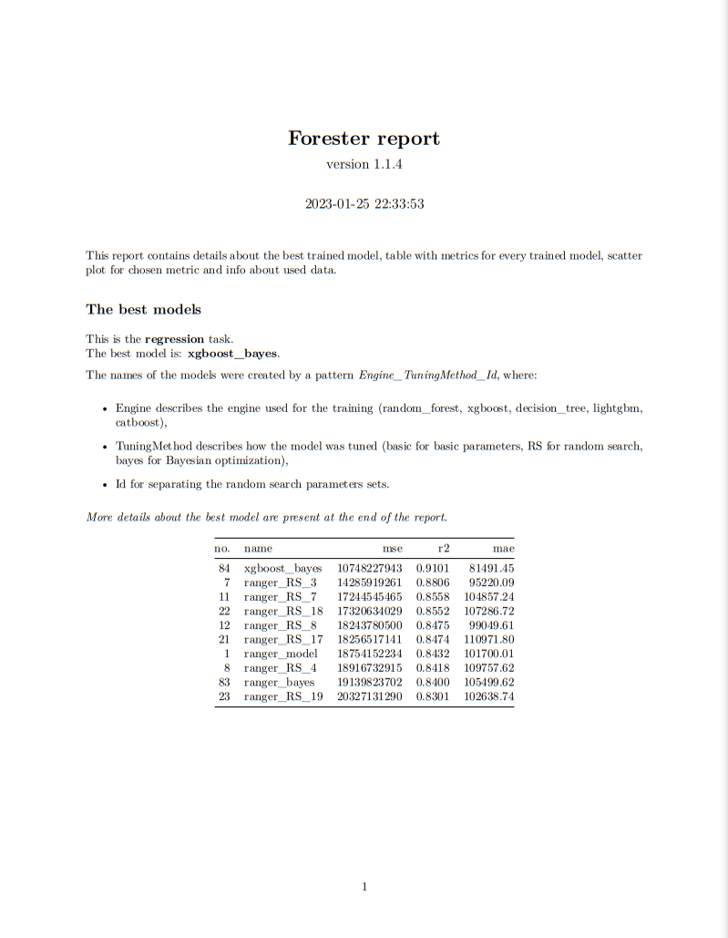
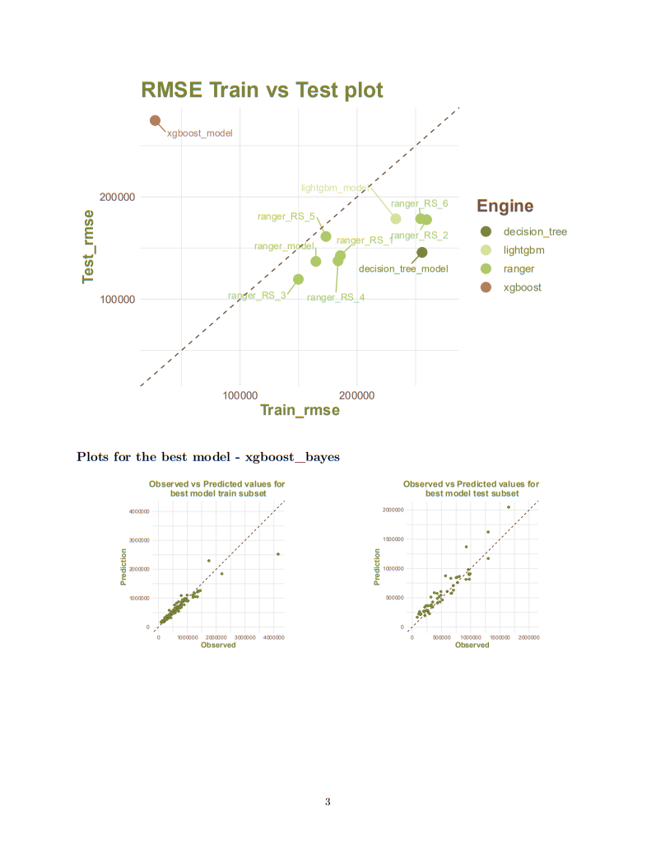
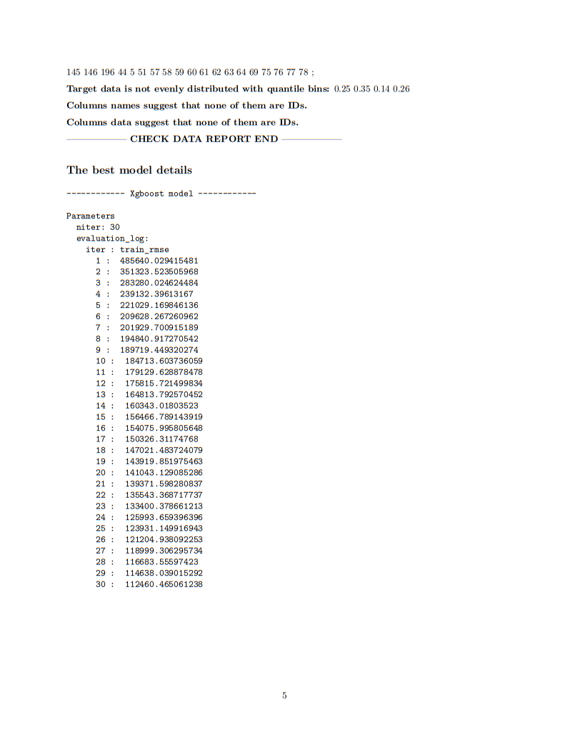
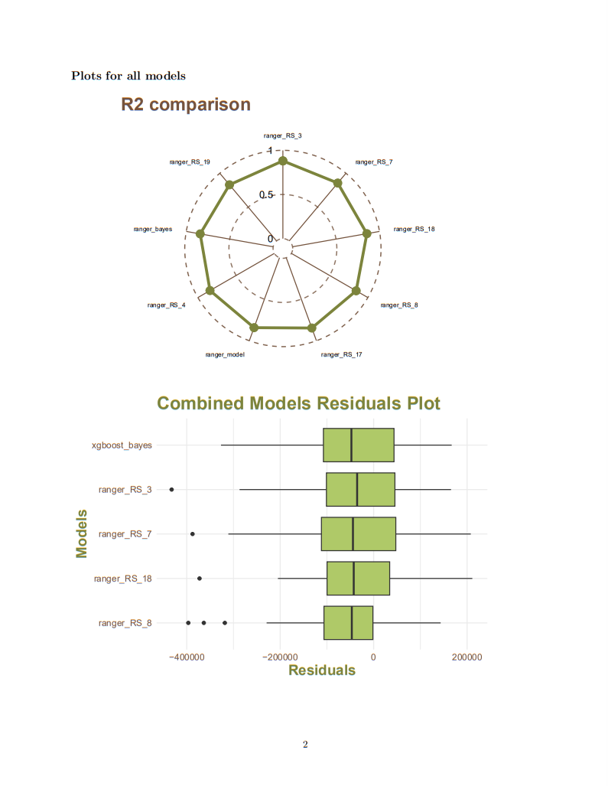
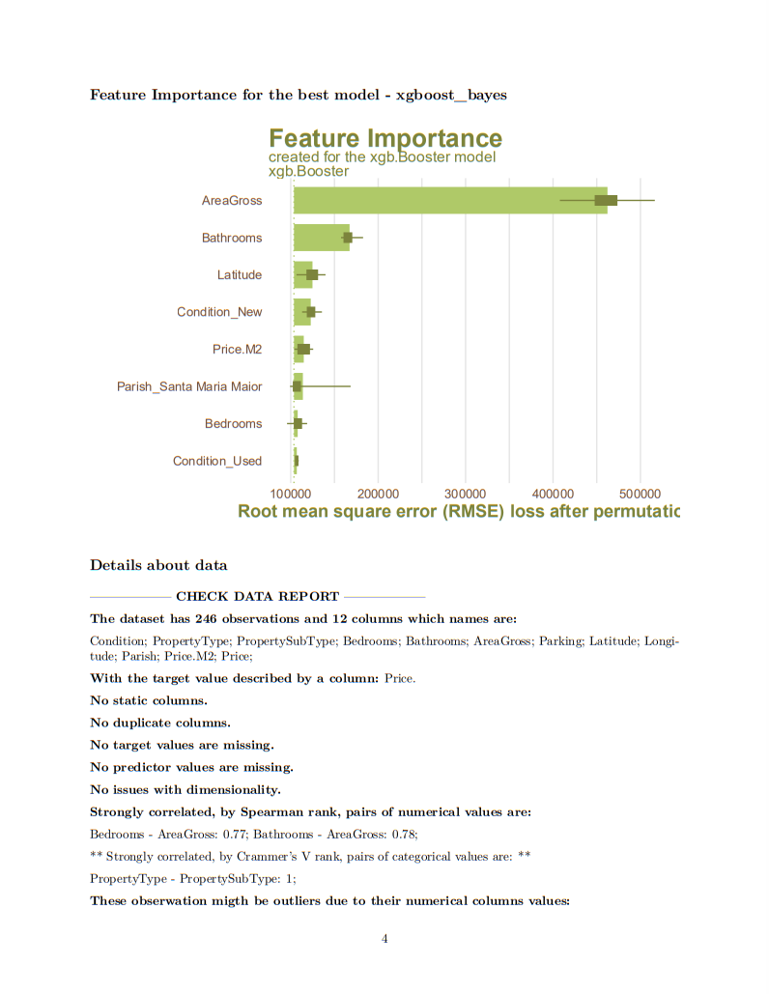
Automatic reports and XAI
Notes:
A final novelty included in our tool is the automatic training report generation. It consists of some basic information about the dataset, raw training results, results of the data quality check, and most importantly lots of visualizations enabling the user to understand obtained outcomes. The plots are suited to the considered ML task, being either regression or binary classification, and consist of three plot types that compare different models, present the outcomes of the best one, or use XAI methods to explain them in a greater detail.

Slide 8
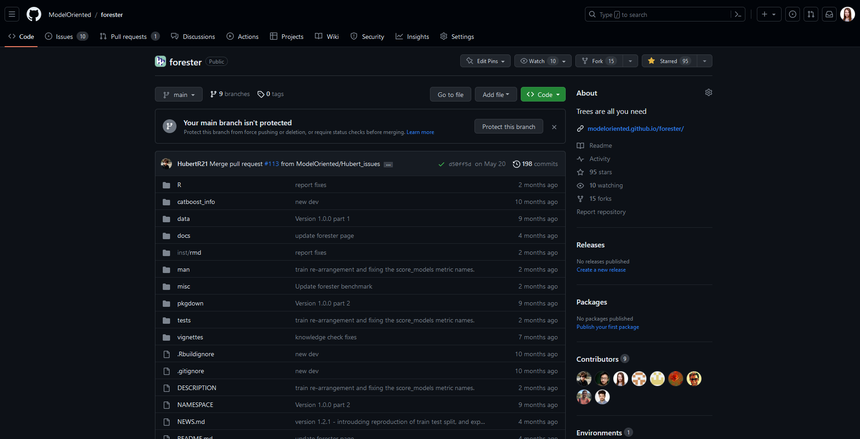
Notes:
To get better familiar with our tool take a look at the GitHub repository and visit the website.

Slide 9
Encourage viewers to try out the package for themselves and provide feedback. albo pogadamy przy posterze
Notes:
Try using the package on your data and let us know how it worked for you. Many thanks for all feedback.
See you at the conference.

